Slide 1
AUTOMATIC CERTIFICATE GENERATOR (USING OPENCV AND PYTHON)

Slide 2
TEAM MEMBERS:
NITIN KUMAR SINGH(181500434)
NIKHIL SINGHAL(181500429)
AMIT VARSHNEY(181500087)

Slide 3
PROJECT MENTOR
PRIYA AGARWAL(TECHNICAL TRAINER)

Slide 4
INTRODUCTION
This project automatic certificate generator using python and OPENCV implements a classic version of Certificate generator.
In this the python script automates the process of generating multiple certificates for a given list of people from a template image file.
This certificate generator includes two.txt files one for name of the candidate with date and another for coordinates files. after all this we run the python code and it will fetch all the details from these .text files and will generates the certificate

Slide 5
ABSTRACT
In this using python script automates the process of generating multiple certificates for a given list of people from a template image file.
this script will take care of the generation of certificate for different people using txt file as an input of names and coordinates of template.
To explain it in a better way, say you need to provide digital certificates for any purpose, so create a template for a certificate. It autogenerates the certificates of any event of the individual candidates.
Generating certificate of participation of each attende can be cumbersome and hard work. Automating this job can easily save tons of time and manual work.
We have made this automation possible and quicker than ever. This script can makes thousand of certificates with as simple input as just a name.
Our algorithm's quickest runtime is just seconds to generate a single certificate and with minimum possible memory consumption

Slide 6
SOFTWARE REQUIREMENTS:
TECHNOLOGY:OPEN CV
LANGUAGE USED:PYTHON3
PYTHON IDLE AND OTHER SOFTWARES

Slide 7
HARDWARE REQUIREMENTS:
PROCESSOR USED: Intel Pentium or above
OPERATING SYSTEM: Win 7 OR above
RAM: 4GB OR above
HARDWARE DEVICES : Computer or Laptop System
HARD DISK:256GB OR above

Slide 8
PROBLEM STATEMENT
I am a core-committee member of the University Coding Club, and hence we organize many competitions, workshops or events where we need to provide a certificate of participation to the users. So we require to generate large amount of certificates for this competitions

Slide 9
OBJECTIVE
Automatic Certificate Generator aims to generate the large amount of digital certificates for many competitions, workshops and events.
It also aims to ease the manual work as a university or other institute members to distribute certificates to the participants using python script(Open CV) that automates the process of generating certificates from given template. Simply edit the input and output file for the CSV input and template image and the generated certificates files and run it.

Slide 10
IMPLEMENATION
We make this project by making two sets which is set coordinates and generate certificate so in set coordinate we set the coordinates of name and date and in case of generate certificate we select text file of names and also change default date and generate multiple certificates.
And also we required to implement various libraries such as PIL,openCV,csv,os,numpy.this libraries played an important role for automation of certificates .
First we check whether these libraries are present on system or not.we iinstall these by using pip and then import these libraries by import method.

Slide 11
LIBRARIES
PIL(Python Image Library) is used Imagefont, Imagedraw and Image.it is used for opening,manipulating and saving many different image file formats.
OpenCV is the huge open-source library for computer vision, machine learning, and image processing and now it plays a major role in real-time operation which is very important in today’s systems. By using it, one can process images and videos to identify objects, faces, or even the handwriting of a human.
The CSV module implements classes to read data in CSV format. It allows programmers to say, “write this data in the format.. the CSV formats understood by other applications or define their own special-purpose CSV formats.
The OS module allows interaction with the Operating System, either generically or specific to a particular OS. NUMPY is a Python package. It stands for 'Numerical Python'. It is a library consisting of multidimensional array objects and a collection of routines for processing of array

Slide 12
libraries
from PIL import imageFont,ImageDraw,Image
import cv2
import numpy as np
import os
import csv

Slide 13
CODING
from PIL import ImageFont, ImageDraw, Image
import cv2
import numpy as np
import os
import csv
f = open("names.txt","r")
names_list = f.read().split("\n")
#print(names_list)
f1 = open("coords.txt","r")
coordinates = f1.read().split("\n")
flag=True
for i in range(len(names_list)):
name_to_print = names_list[i]
date_to_print = "20/11/2020"#Change this date as per requirement
# Load image in OpenCV
image = cv2.imread("ce3.jpg")
# Convert the image to RGB (OpenCV uses BGR)
cv2_im_rgb = cv2.cvtColor(image,cv2.COLOR_BGR2RGB)
# Pass the image to PIL
pil_im = Image.fromarray(cv2_im_rgb)
draw = ImageDraw.Draw(pil_im)
# use a truetype font
font = ImageFont.truetype("./fonts/MLSJN.TTF", 29) #You can change fonts from list given bottom
font1 = ImageFont.truetype("./fonts/OLDENGL.TTF", 22)
# Draw the text
draw.text((int(coordinates[0]), int(coordinates[1])), name_to_print, font=font , fill='black')
draw.text((int(coordinates[2]), int(coordinates[3])), date_to_print , font=font1, fill='blue')
# Get back the image to OpenCV
cv2_im_processed = cv2.cvtColor(np.array(pil_im), cv2.COLOR_RGB2BGR)
if flag:
cv2.imshow('Certificate', cv2_im_processed) #Shows sample image
flag=False
path = ''
cv2.imwrite('./output/'+name_to_print+'.png',cv2_im_processed)
#os.startfile('output.png')
cv2.waitKey(0)
cv2.destroyAllWindows()

Slide 14
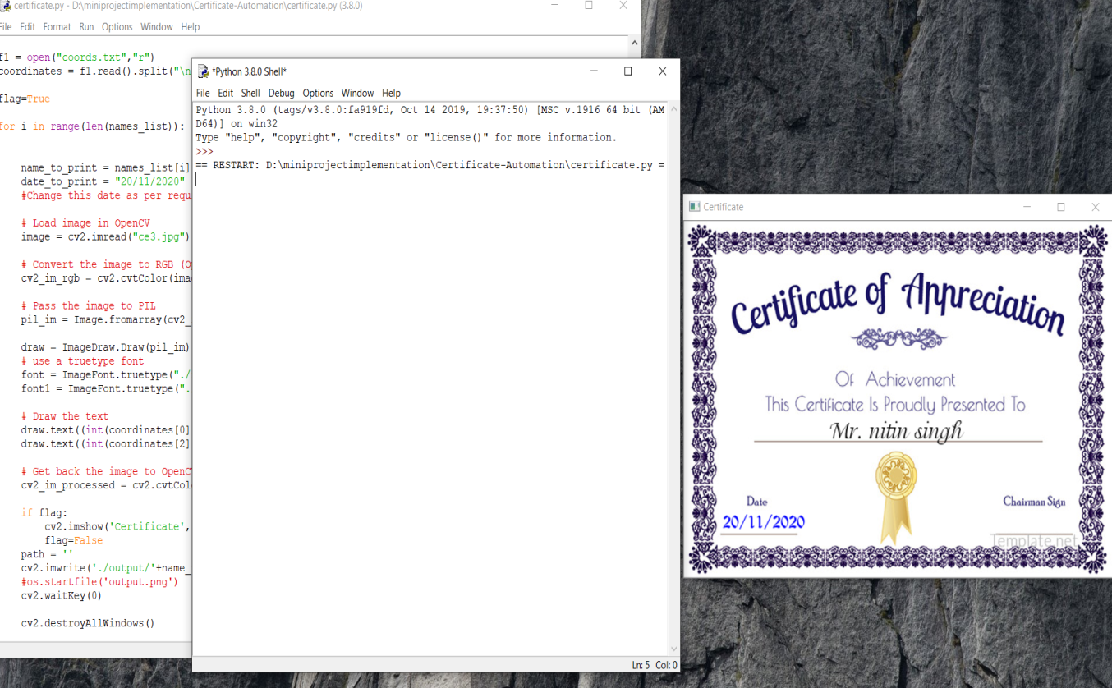
FINAL OUTPUT
RUN CERTIFCATE FILE

Slide 15
FUTURE OF PROJECT
I am a core-committee member of the University Coding Club, and hence we organize many competitions, workshops or events where we need to provide a certificate of participation to the users. To make this process automated, I decided to write a small helper script to provide me with ready to send, automatically generated certificates.
Any event usually involves a lot of participants and generating handwritten certificates for each one of them and sending them digitally is a really tedious task. Automating this job can easily save tons of time and manual work and thus also reducing the error rate. This Python script generates certificates with the persons name, reading from an excel file after loading a template certificate in the script.

Slide 16
NITIN KUMAR SINGH NIKHIL SINGHAL AMIT VARSHNEY
THANK YOU

